Slide 1
Digital Control System Analysis and Design
Chap. 1 Introduction
Chap. 2 Discrete Time Systems and the z-Transform
Chap. 3 Sampling and Reconstruction
Chap. 4 Open-Loop Discrete-Time Systems
Chap. 5 Closed-Loop Systems
Chap. 6 System Time-Response Characteristics
Chap. 7 Stability Analysis Techniques
Chap. 8 Digital Controller Design

Slide 2
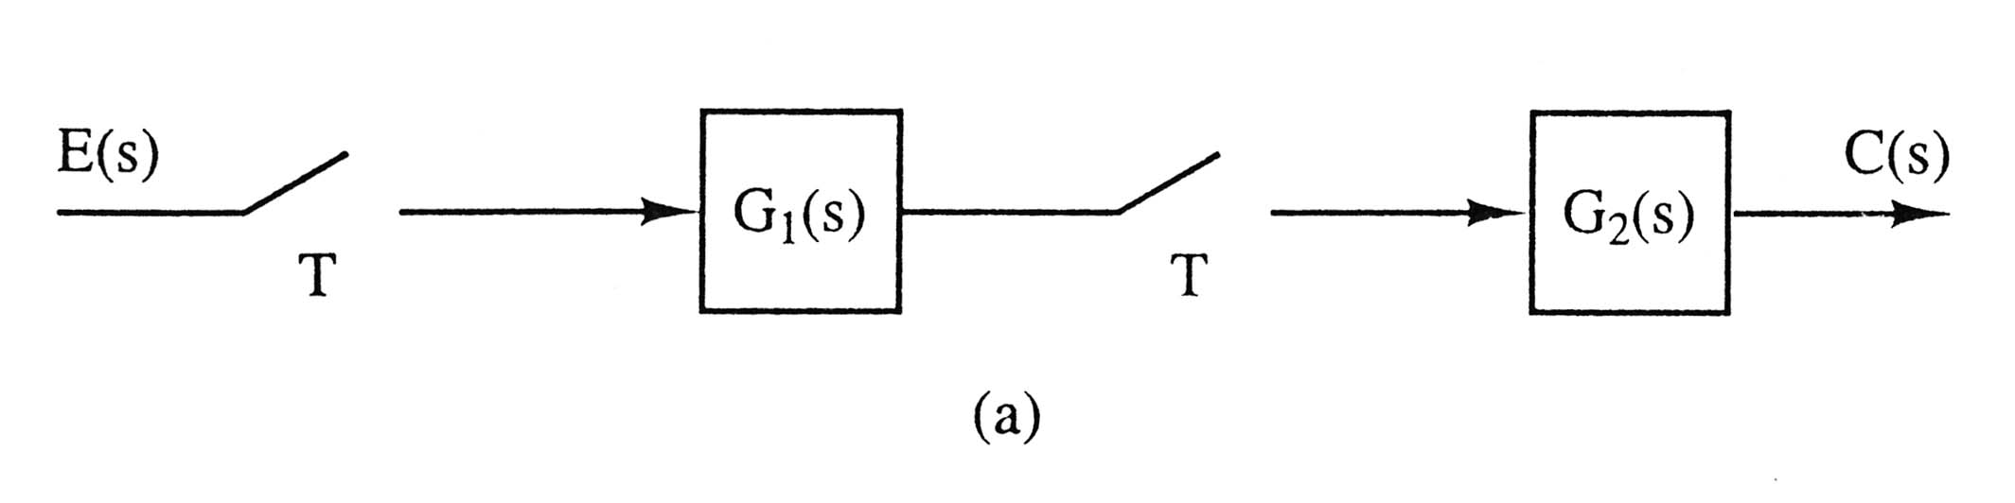

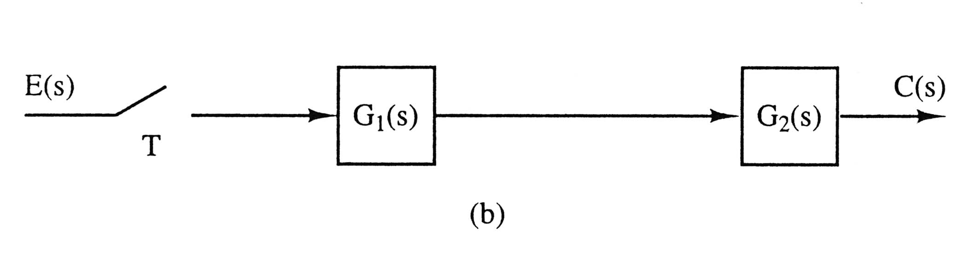

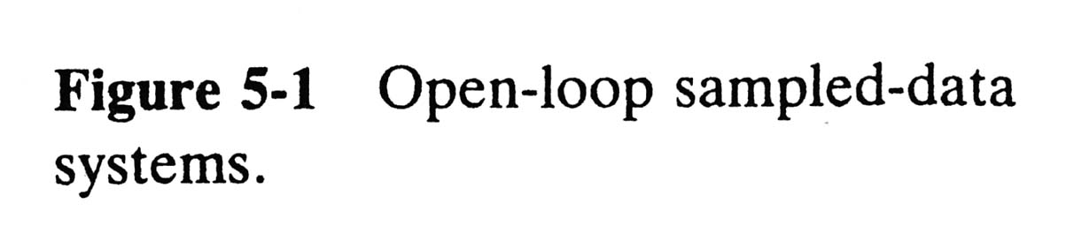
5.2 Preliminary Concepts

Slide 3
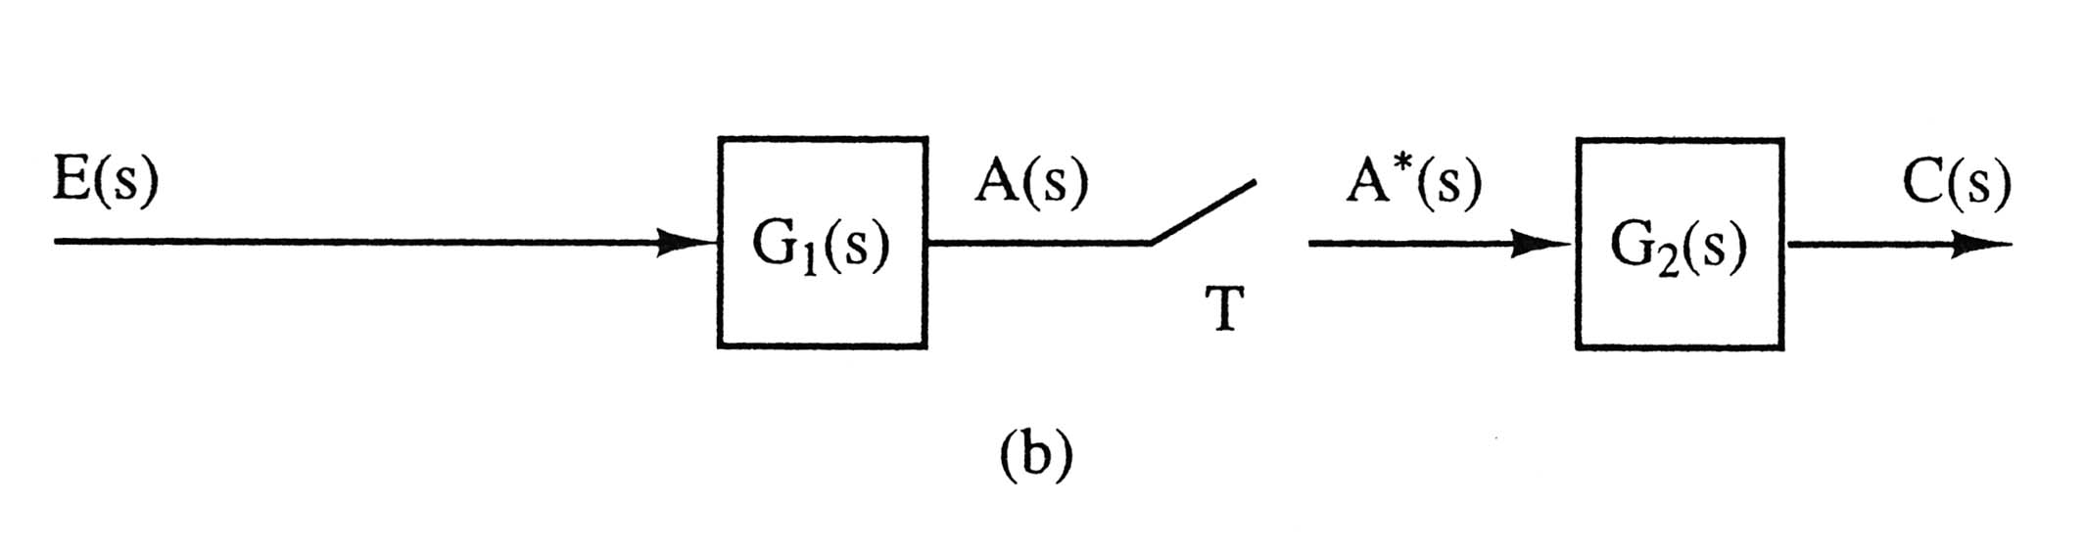

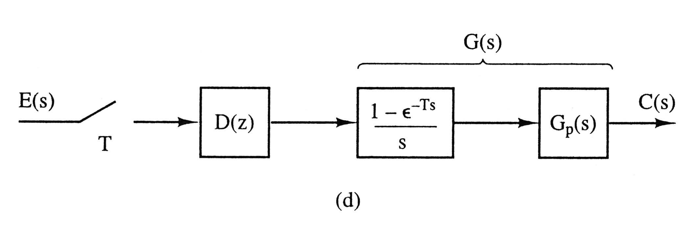
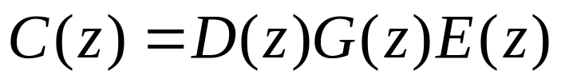
Figure 5-1-cd
(c)
No TF, but the output C can be expressed as a function of the input E.
Compare (d) with (a).

Slide 4
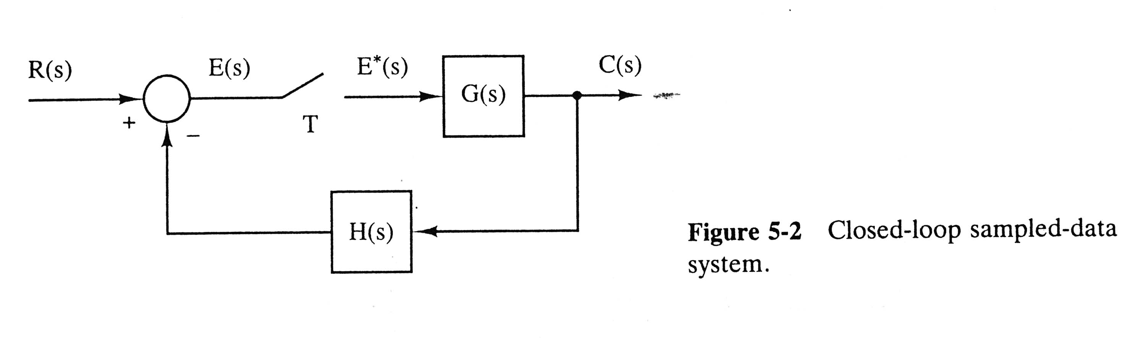

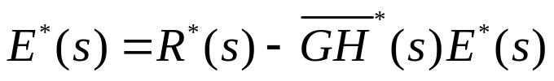

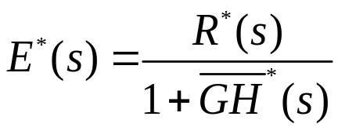

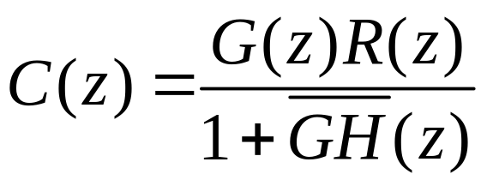
Closed-Loop Systems
(5-5)
(5-9)
→
(5-11)
Transfer function?

Slide 5
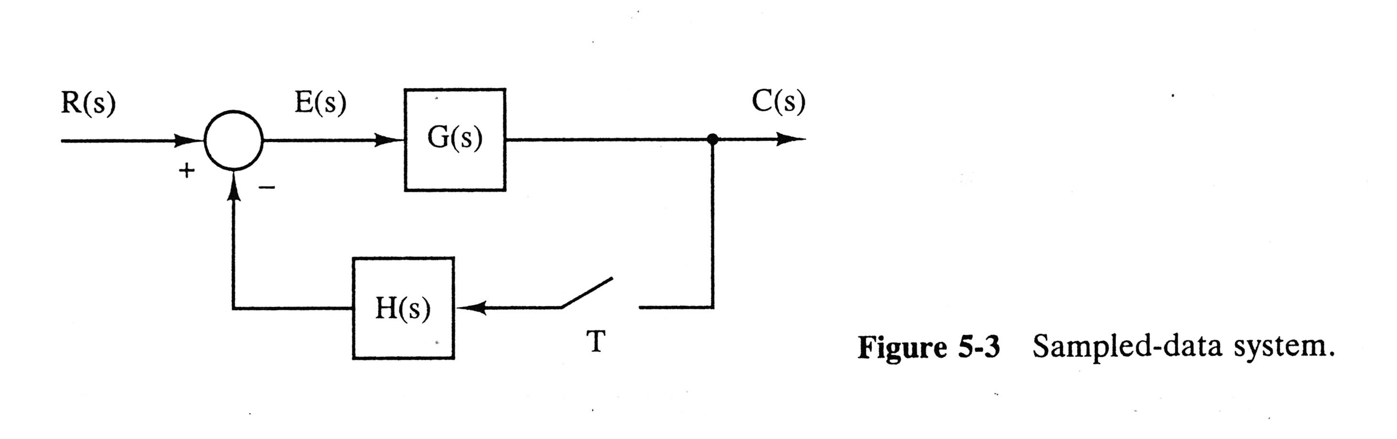
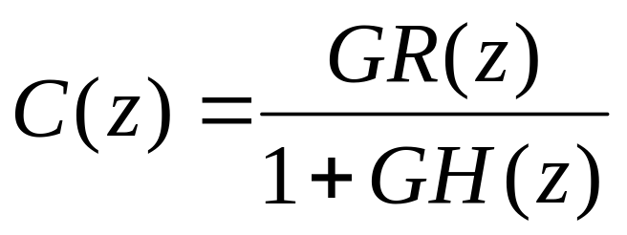
(5-18)
Transfer function?
No transfer function can be derived, since r(t) is not sampled.

Slide 6
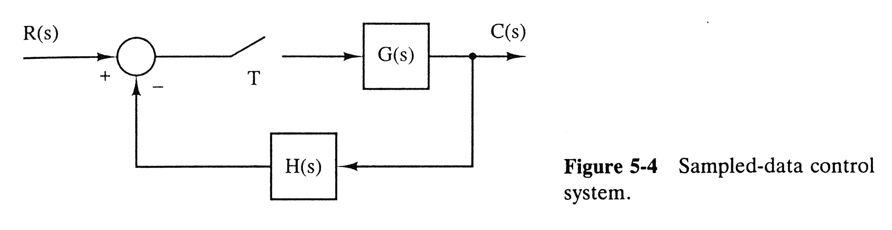
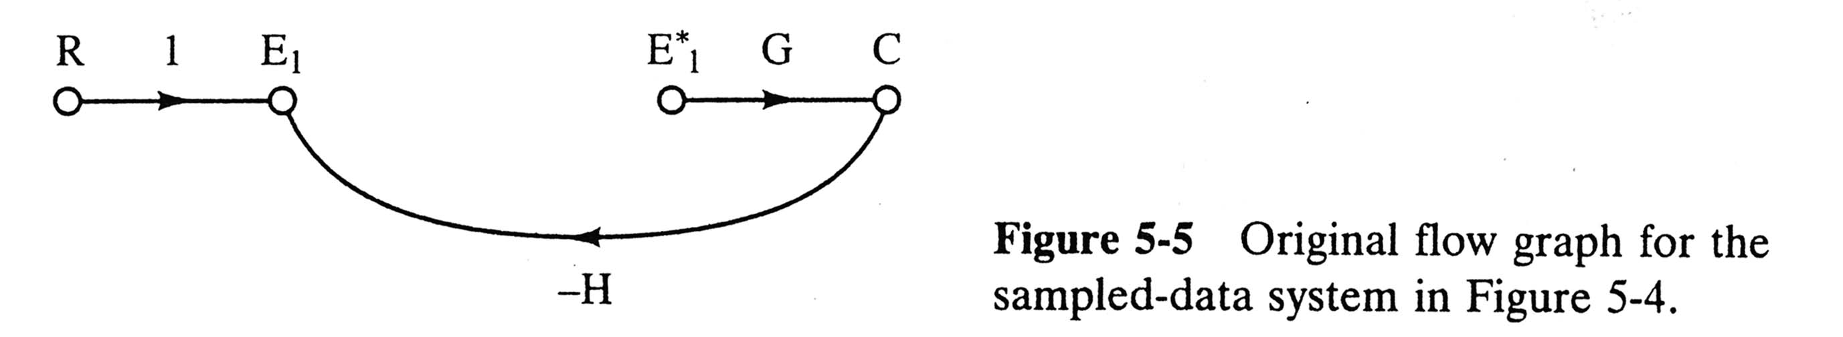
5.3 Derivation Procedure
Finding TF for sampled-data system is difficult (due to ideal samplers).
原始流程圖

Slide 7
Step-by-Step Procedure
Construct the original signal flow graph (SFG).
Assign a variable to each sampler input. (E₁)
Considering each sampler output (E₁*) to be a source node (input), express the sampler inputs (E₁) and the system output (C) in terms of inputs (R and E₁*).
Take the starred transform of these equations and solve by any convenient method.
More than one sampler?
→ Cramer’s rule vs. Mason’s formula (sampled SFG).
取樣流程圖

Slide 8
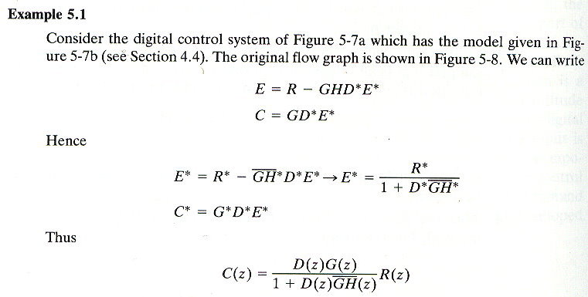
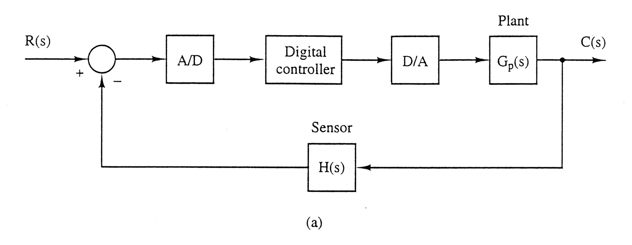
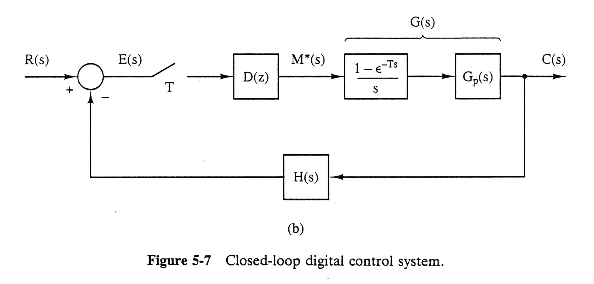

Slide 9
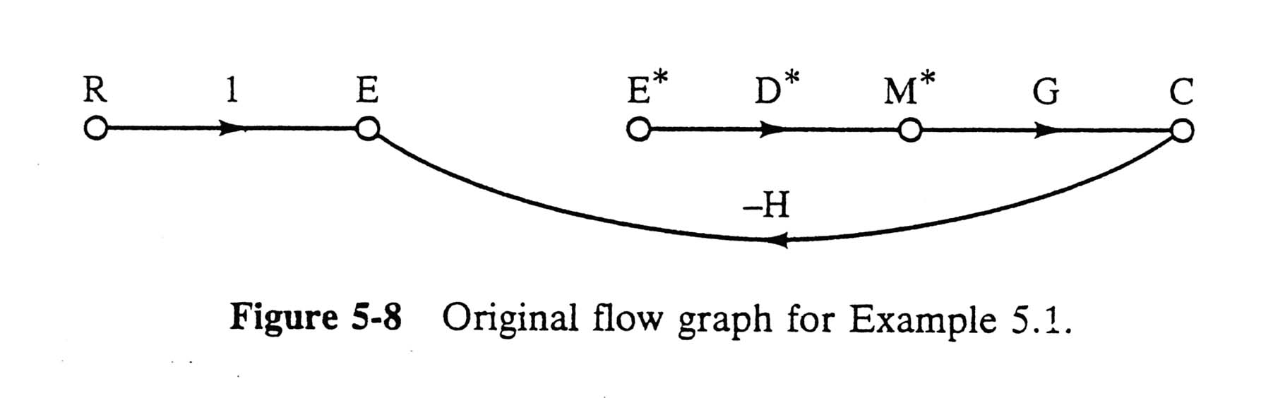

Slide 10
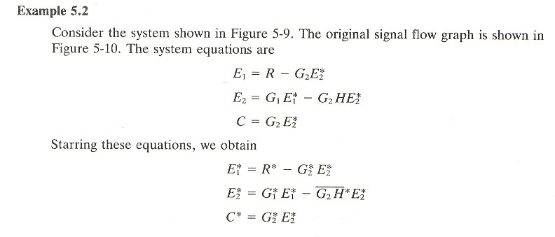
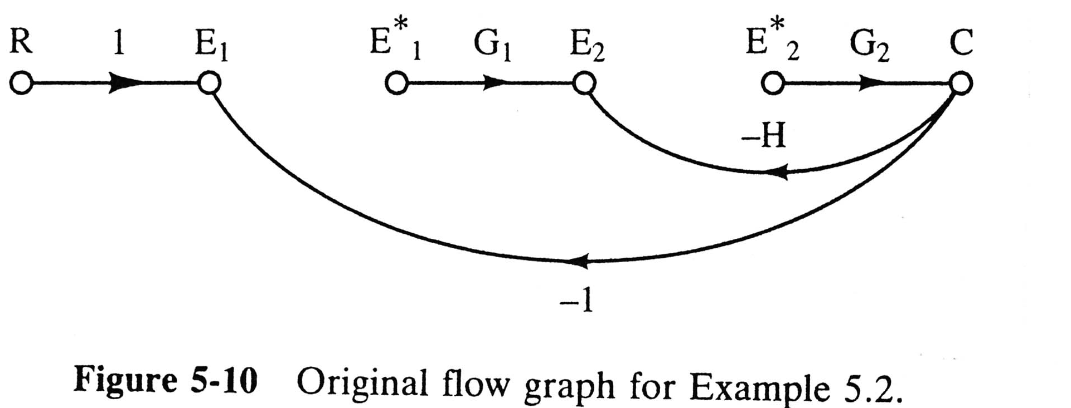
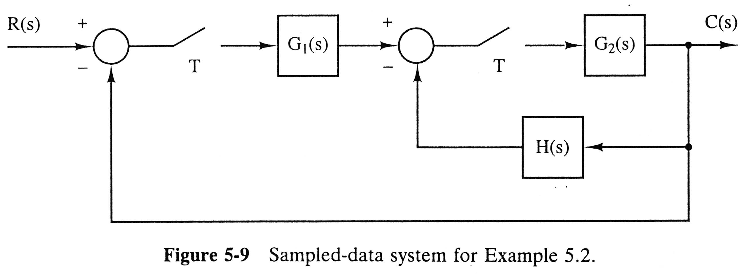
Produce Sampled SFG

Slide 11
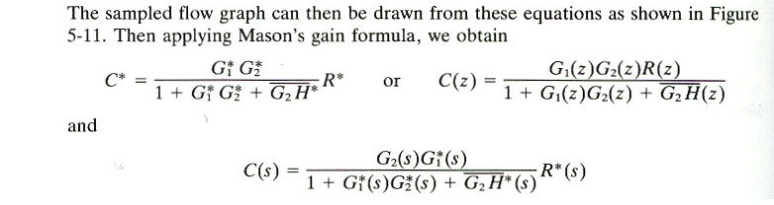
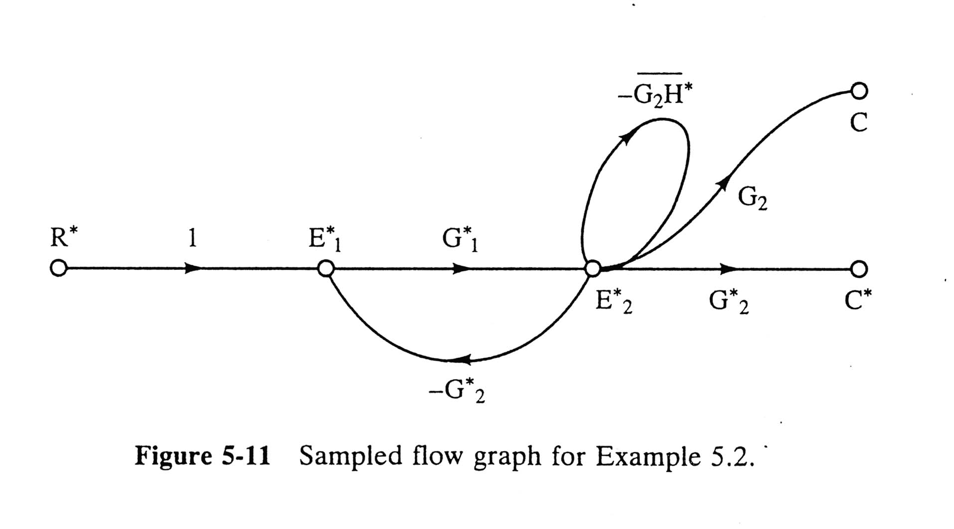
Produce Sampled SFG
Produce Sampled SFG
取樣流程圖 (without disconnections inside)

Slide 12
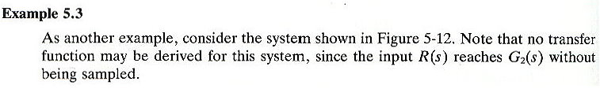
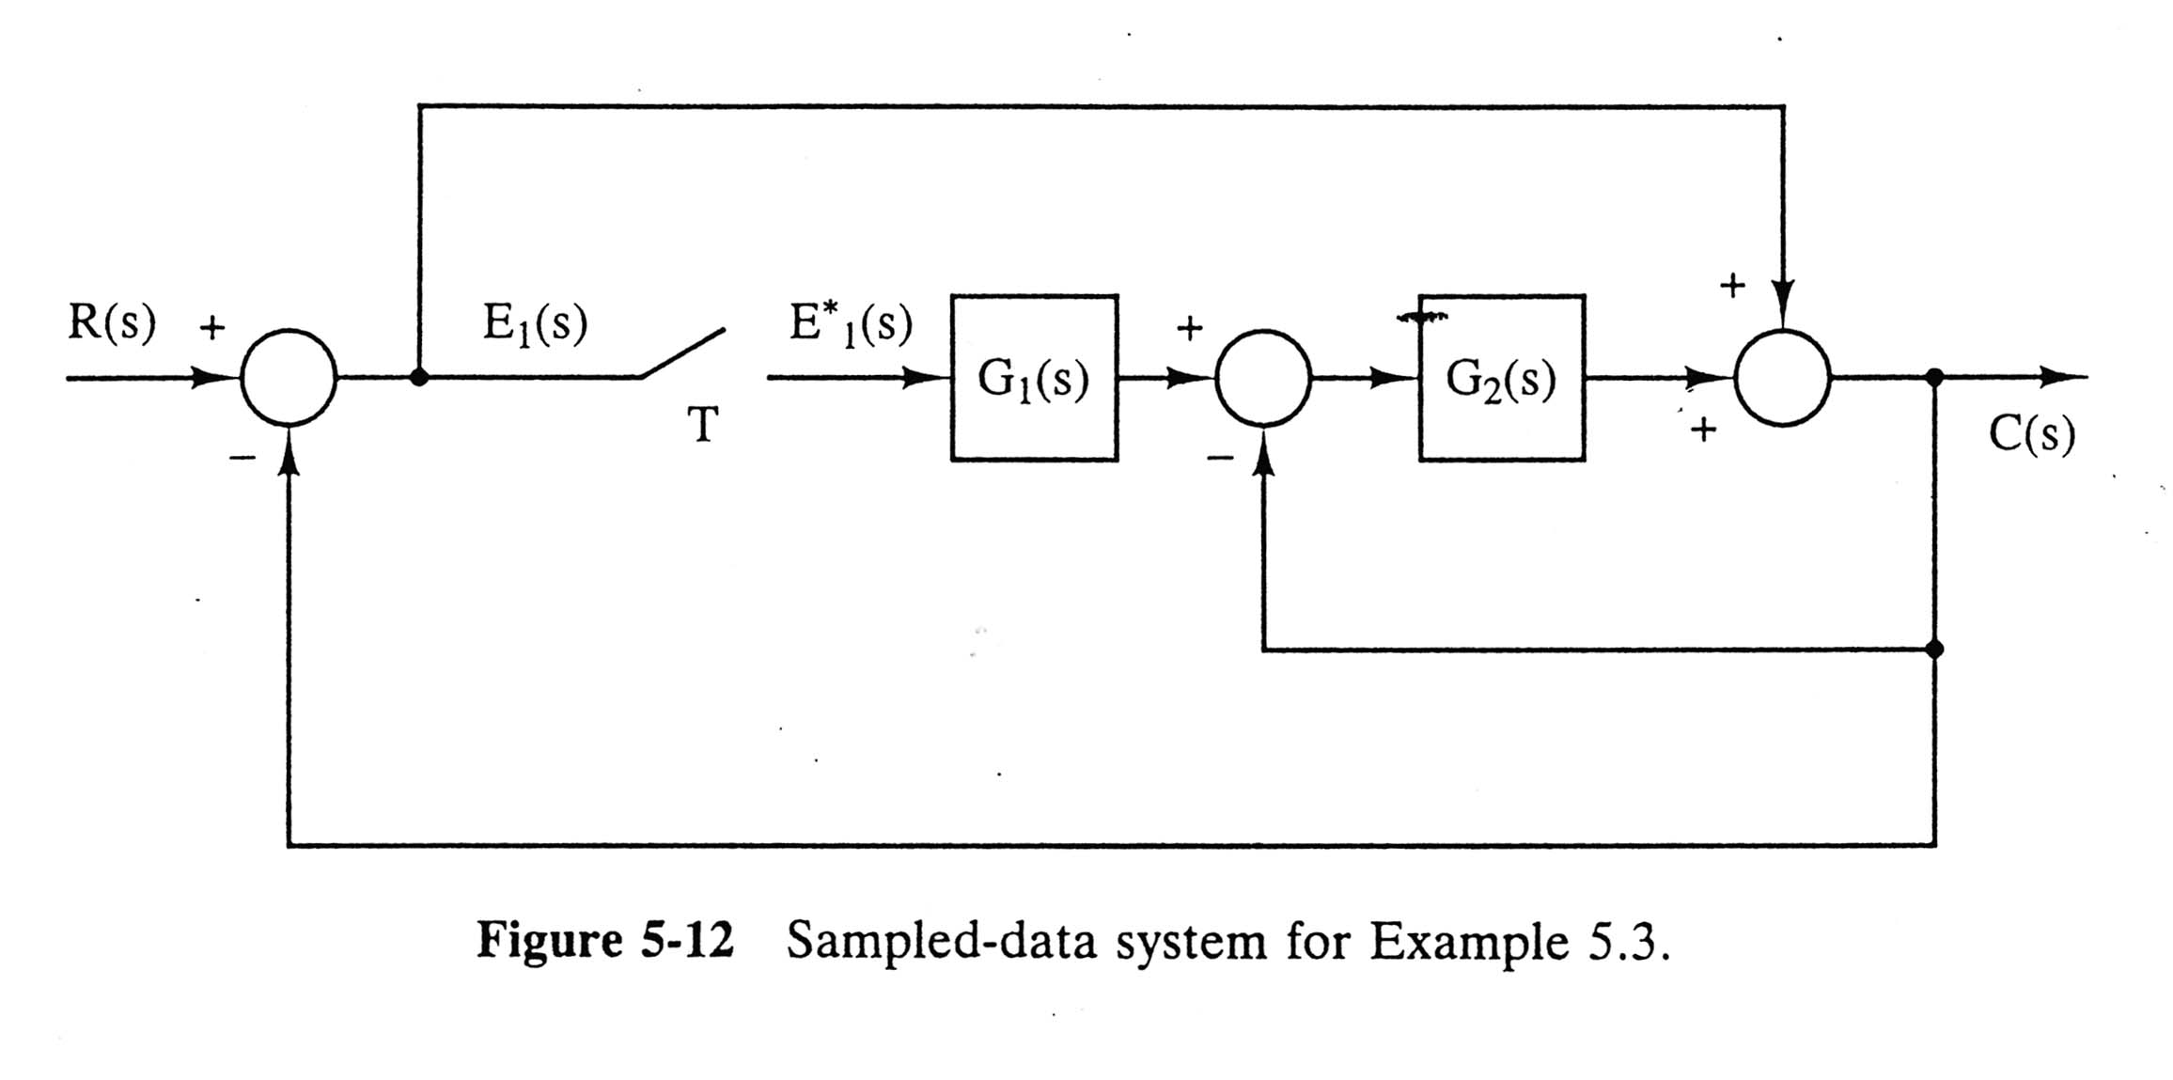
Remind: Feedforward Matrix “D” (Ch. 2)

Slide 13
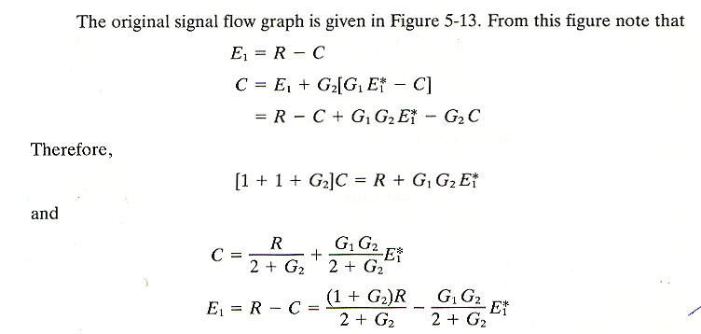
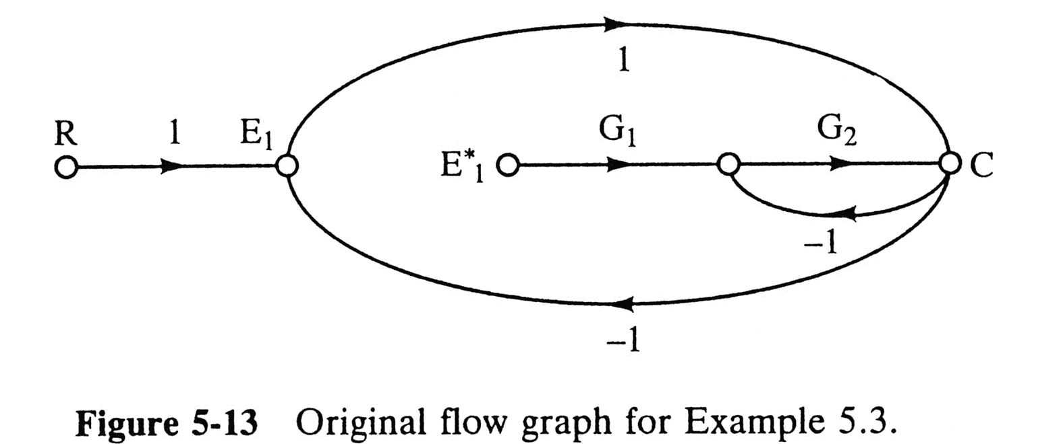

Slide 14
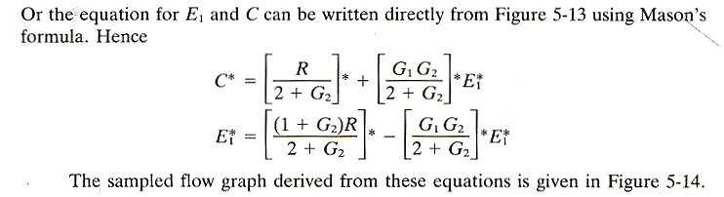
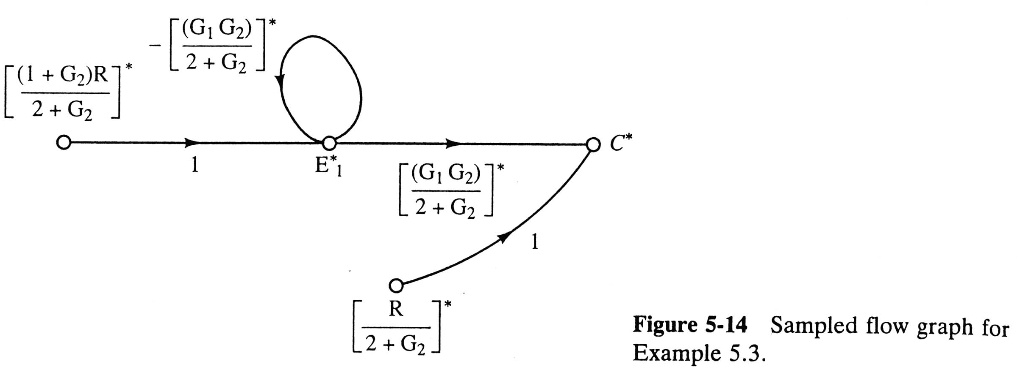
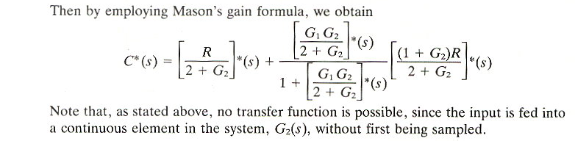

Slide 15
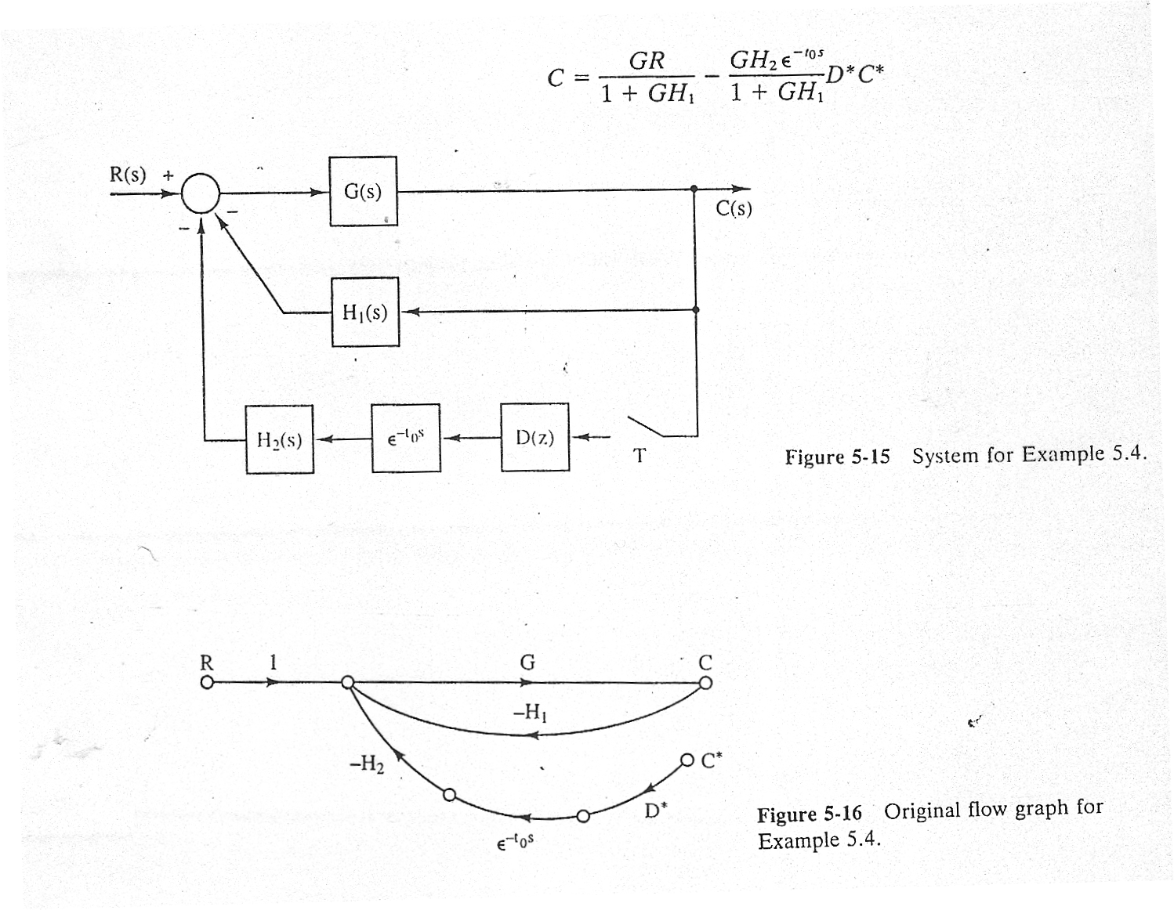
Example 5.4. Computation Time Delay: t₀ < T
From Mason’s formula.

Slide 16
See Summary (P191)
Problems: 1, 2, 3,
8, 9, 10, 11
Test Bank

